Slide 1

DriverPass System Analysis
Corey Wallace
Notes:
[No speaker notes required for this slide.]

Slide 2

System Requirements
Two Functional Requirements
Let customers have the ability to choose one of the packages offered.
Let students be able to schedule their own lessons for driving.
Two Nonfunctional Requirements
Reliability
Performance
Notes:
[In your speaker notes, include an explanation of the different requirements you determined for DriverPass’s system. What are the functional requirements you selected to describe? What are the nonfunctional requirements you selected to describe? Be sure to explain how these requirements meet DriverPass’s needs.]

Slide 3
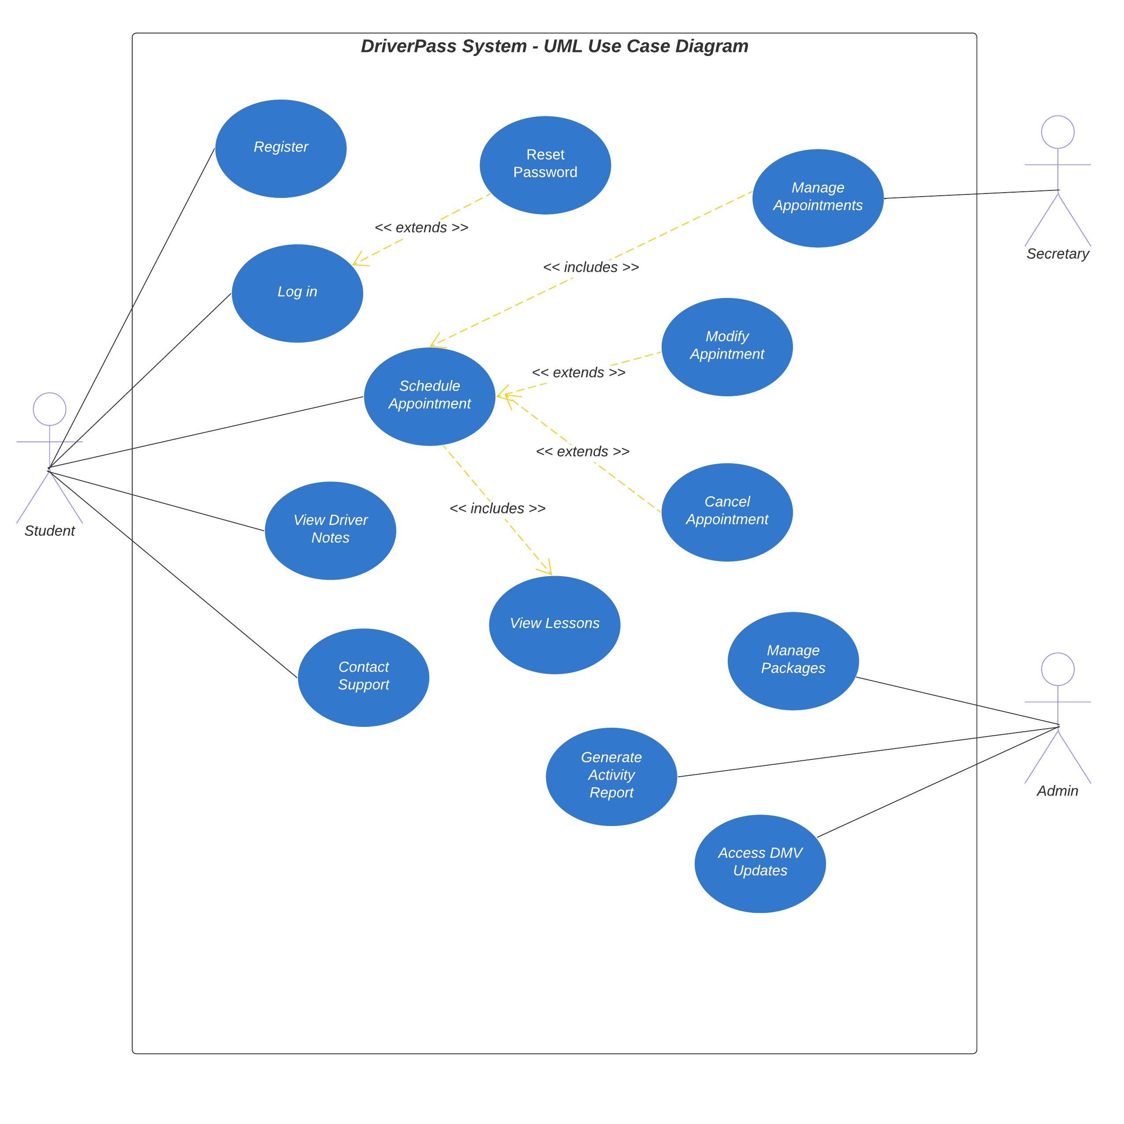
Use Case Diagram
Notes:
[Explain your diagram. Who are the different actors in the system? What are the different use cases? How did you account for DriverPass’s needs in your design? In your explanation, keep your audience in mind. Avoid the use of terms like “actors” and “use cases” in your explanation.]

Slide 4
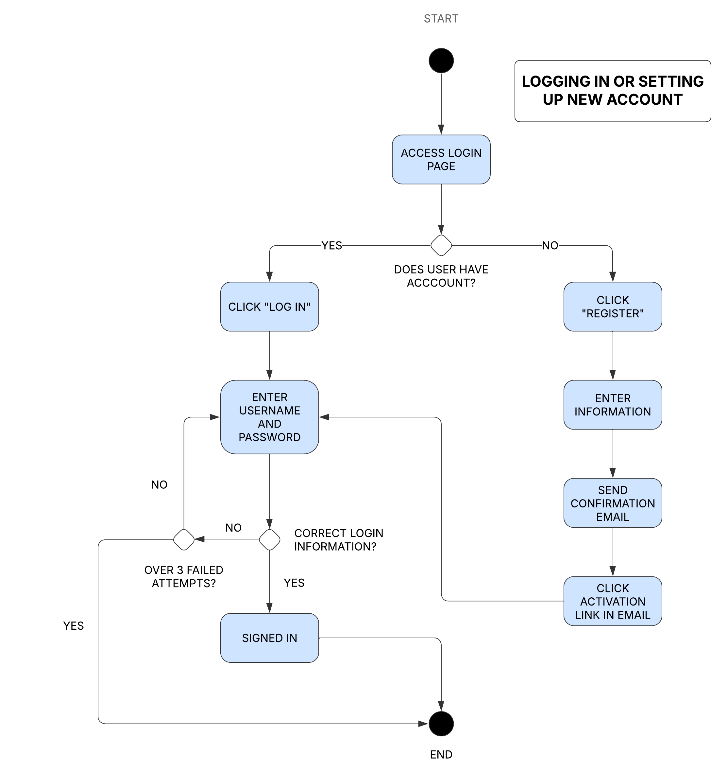
Activity Diagram
Notes:
[Explain your diagram. Which use case are you breaking down? What are the steps for this use case? How did you account for DriverPass’s needs in your design? In your explanation, keep your audience in mind. Avoid the use of technical terms such as “nodes,” “control flows,” and so on.]

Slide 5
Security
User can have no more than three failed login attempts.
User has password (they create) that is case sensitive. The password must have uppercase, lowercase and special characters in it.
Systems must stay up to date to help prevent security issues.
Notes:
[How did you consider security in your design? In your explanation, keep your audience in mind by avoiding the use of technical terms.]

Slide 6
System Limitations
Time to finish product
Customer Hardware
Client Hardware
Budget from client
Their IT department's knowledge of the program after we release it
Notes:
[What are the limitations of your design? In your explanation, keep your audience in mind by avoiding the use of technical terms.]

